Slide 1
College admission agent
IBM HACKATHON PROJECT
Presented By:
Student name : Vishakha
College Name : Ch. Ranbir Singh State Institute of Engineering and Technology
Department: Computer Science & Engineering

Slide 2
OUTLINE
Problem Statement
Technology used
Wow factor
End users
Result
Conclusion
Git-hub Link
Future scope
IBM Certifications

Slide 3
Problem Statement
Colleges receive thousands of similar queries:
"Am I eligible for B.Tech?"
"What is the last date to apply?"
"What documents are needed?“
FAQs and brochures are static and often ignored.
Staff spends hours responding to repetitive questions.
No personalized guidance or smart course matching.
Navigating college admissions is often confusing for prospective students due to scattered and complex information across institutional websites. Manual inquiries to admission offices result in delays and inconsistent responses.

Slide 4
Technology used
Frontend: React.js (Chat UI)
Backend: Node.js with Express
Retrieval- Augmented Generation (RAG)
AI Layer (RAG):
IBM Watson AI Studio (Retrieve)
IBM Granite LLM (Generate)
Database: IBM Cloudant
Deployment: IBM Code Engine (Dockerized)

Slide 5
IBM cloud services used
IBM Watson AI Studio: Extracts data from PDFs & documents
IBM Watsonx AI Runtime
IBM AgentLab (for deployment)
IBM Granite Model: Generates context-aware responses
IBM Cloudant: Stores FAQs and structured admission data
IBM Code Engine: Serverless deployment for scalability

Slide 6
Wow factors
AI-Powered Query Resolution
Answers admission queries instantly using IBM Granite LLM.
RAG for Accuracy
Combines retrieval from trusted sources (Watson Discovery) + generation for reliable answers.
Real-Time Information
Updates automatically when institutional data changes.
Cloud-Native & Scalable
Runs on IBM Code Engine, ensuring high availability and autoscaling.
Student-Friendly Interface
Simple chatbot UI for natural language questions.
Reduced Manual Workload
90% reduction in repetitive queries handled by staff.
Personalization
Suggests courses and eligibility based on user input.

Slide 7
End users
Students
To get admission details, eligibility, deadlines, and fee structure instantly.
Parents
To understand financial details and process without visiting campus.
College Admission Teams
To reduce repetitive inquiries and save time.
Educational Consultants
To guide multiple students using a single reliable platform.

Slide 8
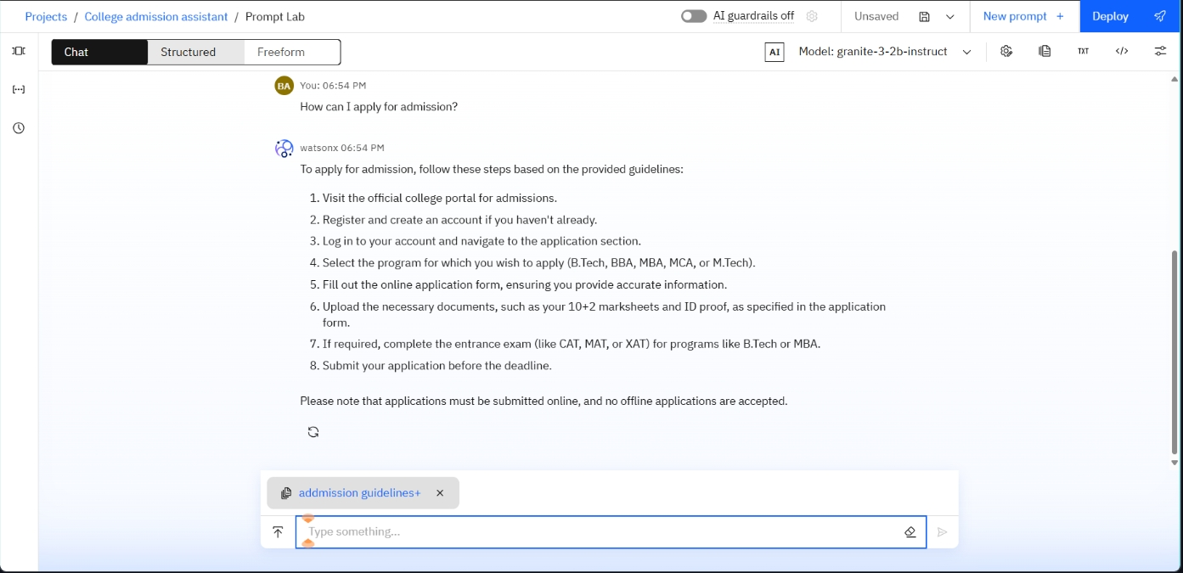
Results

Slide 9
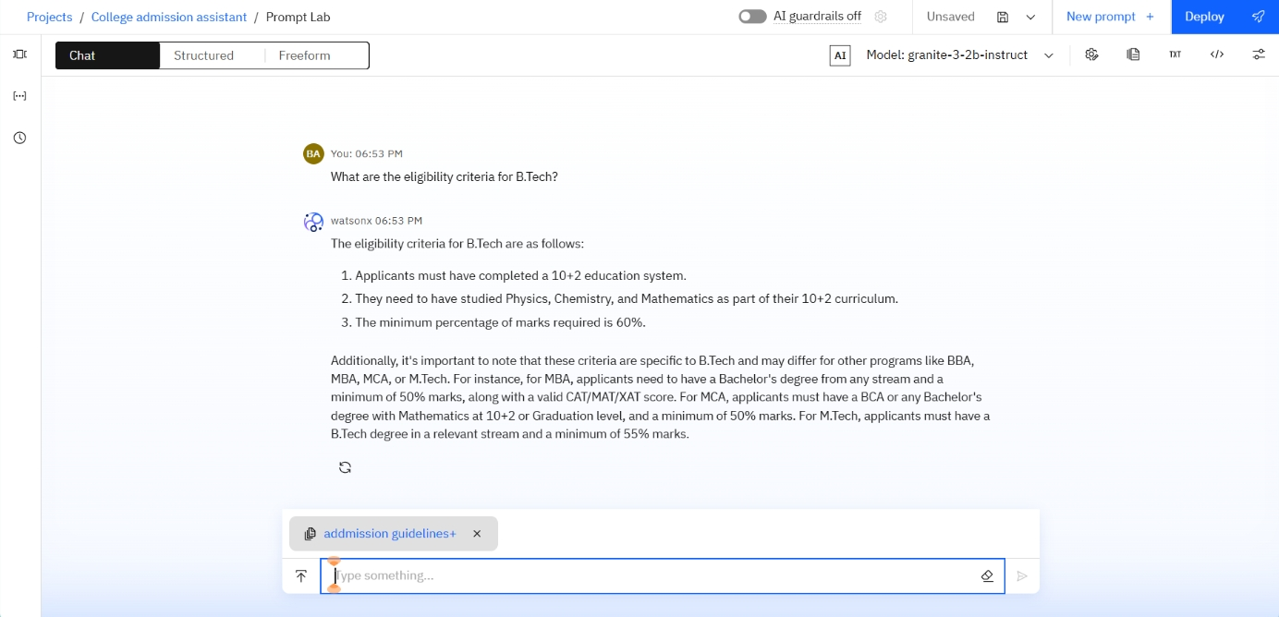
Results

Slide 10
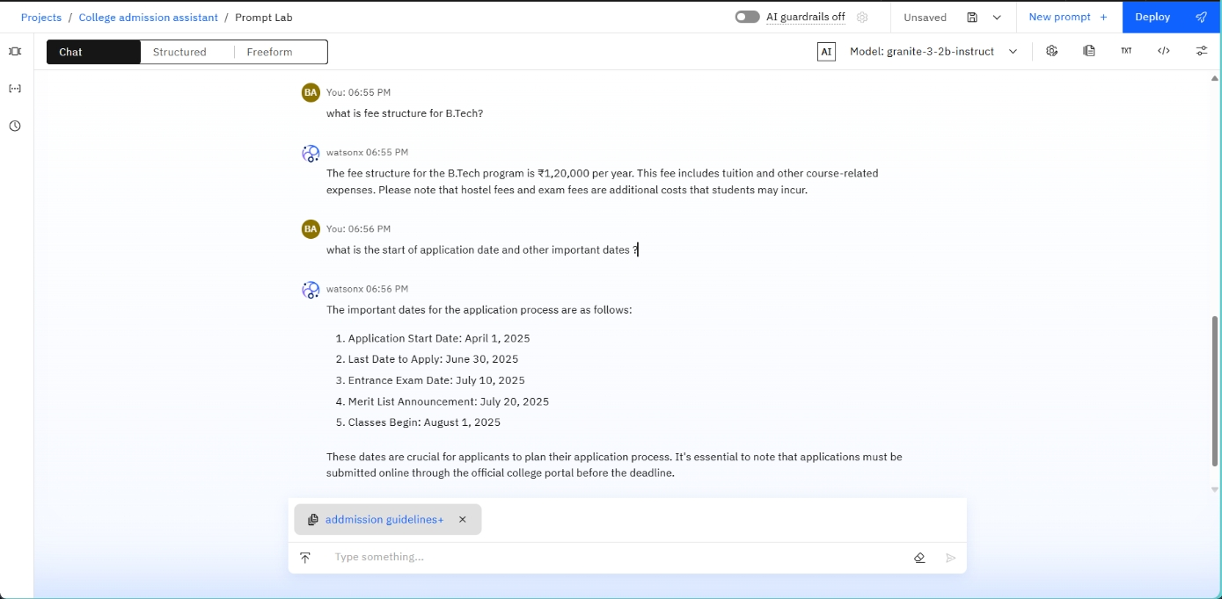
Results

Slide 11
Results
• AI chatbot interface answers admission queries instantly
• Handles eligibility, deadlines, and fee structure
• Improves transparency and efficiency
Architecture Flow:
User → React UI → Node.js Backend → RAG Service → IBM Watson Discovery + Granite LLM → Response

Slide 12
Conclusion
A modern, RAG-based College Admission Agent simplifies and improves the student application process.
Using IBM’s trusted ecosystem:
Watson Discovery
Granite LLM
Code Engine
This project bridges the gap between AI, accurate information, and student needs.
The College Admission Agent enhances the admission experience by providing real-time, personalized, and accurate guidance using AI. It improves transparency, reduces manual tasks, and ensures students are well-informed throughout the process.

Slide 13
GitHub Link
https://github.com/vishakha-create/college-admission-agent.git

Slide 14
Future scope
Multi-language Support
Extend the chatbot to multiple languages for wider accessibility.
Voice-Activated Assistance
Implement voice queries (via Watson Speech-to-Text) for more intuitive interaction.
AI-Powered Recommendations
Use AI to suggest courses and career paths based on user interests and academic background.
Integration with Social Media
Provide admission information through WhatsApp, Facebook, and SMS.
Automated Fee Payment Integration
Allow students to apply, pay fees, and track the status directly via the platform.
Advanced Analytics for Colleges
Offer data insights to colleges about prospective student behavior and engagement.

Slide 15
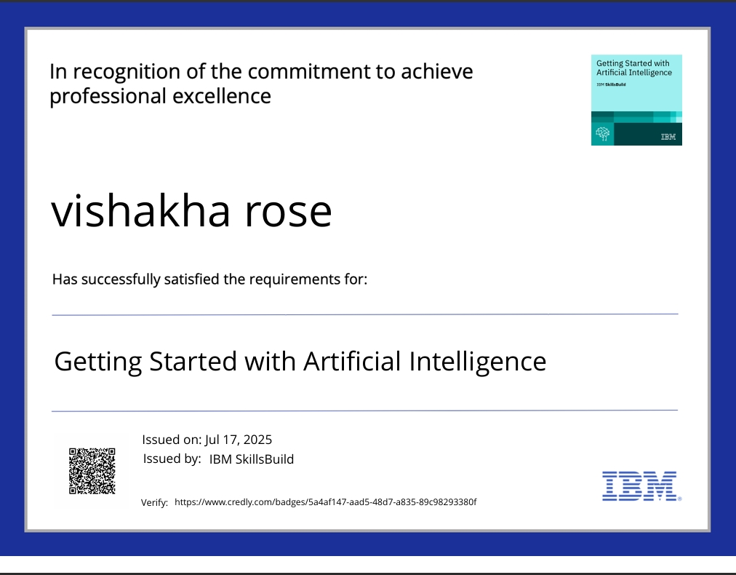
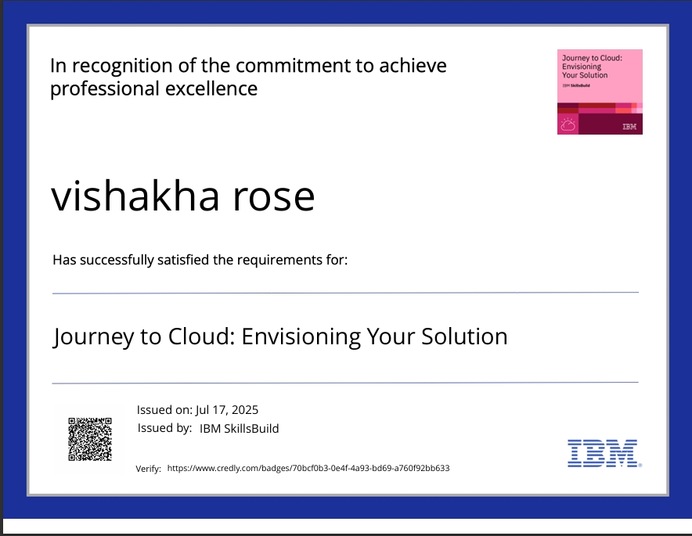
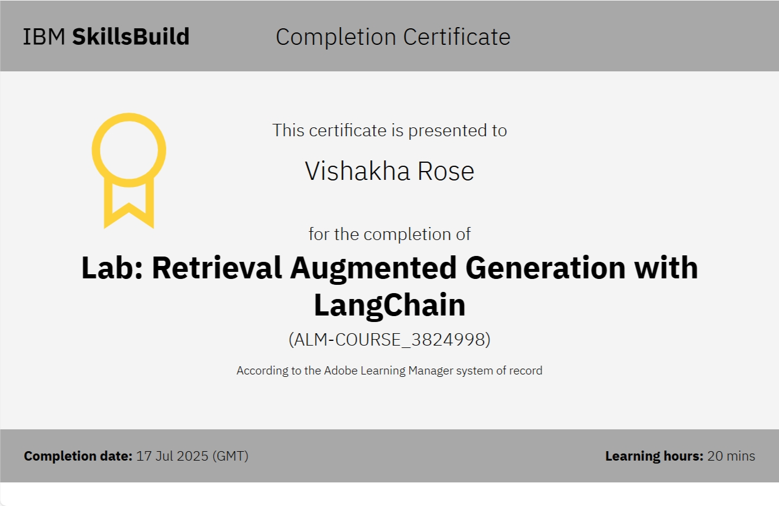
IBM Certifications

Slide 16
THANK YOU

